Slide 1
MAMC01801 Capabilities for Managers
WEEK 5 Corporate Social Responsibility

Slide 2
Corporate Social Responsibility
What is CSR?
A New Zealand example
CSR and SDGs
Stakeholders and CSR
The Social License
CSR reporting
Class exercise: Reading the BP CSR report.

Slide 3

Corporate Social Responsibility What is CSR?
The definition of business success goes beyond profitability, growth rate and brand recognition. In today's world, customers, employees and other stakeholders judge a company by how its activity affects the community, economy, environment and society at large. In other words, by whether it cares about the greater good and not only greater profit. Corporate social responsibility practices are a way to demonstrate a business's stance on the matter.
What Is Corporate Social Responsibility? https://www.businessnewsdaily.com/4679-corporate-social-responsibility.html

Slide 4
Corporate Social Responsibility What is CSR?
Businesses that practice corporate social responsibility aim to improve their communities, the economy or the environment.
Corporate social responsibility, or CSR, is a form of self-regulation that reflects a business's accountability and commitment to contributing to the well-being of communities and society through various environmental and social measures.

Slide 5
Corporate Social Responsibility What is CSR?
CSR plays a crucial role in a company's brand perception; attractiveness to customers, employees, and investors; talent retention; and overall business success.
A company can implement a range of CSR activities, including environmental initiatives, charity work, ethical labour practices and volunteer projects. Stakeholders play a vital role.

Slide 6
Corporate Social Responsibility What is CSR?
Some organisations have a natural affinity towards CSR, for some it’s a work in progress.
Contrast World Vision or the Red Cross with McDonalds or General Motors: the former have set out to make the world a better place, the latter have set out to make money for their owners

Slide 7
Corporate Social Responsibility What is CSR?
Dennis Bakke on the importance of profit:
“Profits are to business as breathing is to life. Breathing is essential to life, but it is not the purpose of living. Profits are essential for the existence of the organisation, but they are not the reason for it to exist”.
Do you think many for-profit businesses would agree with that statement?

Slide 8
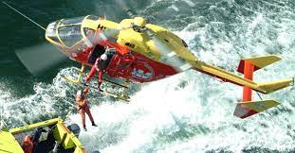
Corporate Social Responsibility A New Zealand example
In New Zealand an obvious example of CSR activity is Westpac’s support of rescue helicopters. Westpac is the principal sponsor of the Auckland, Waikato, Wellington and Canterbury rescue helicopter services and an associate sponsor of the West Coast, Tauranga, Taupo and Palmerston North rescue helicopter trusts. https://chopperappeal.co.nz/about/

Slide 9
An international example - what is this company?
Started in 1868 as a trading company
Pioneered several industries like steel, power, hospitality and airlines
Two-thirds of its equity or 8-14% of its net profit is allocated for philanthropic means
This company had instituted benefits before they were mandatory by law, which includes:
An 8-hour workday
A medical service policy for all employees
Modern pension systems
Maternity benefits in 1928
Profit sharing plans
Scholarships for studies abroad
The group’s welfare department in 1917.

Slide 10
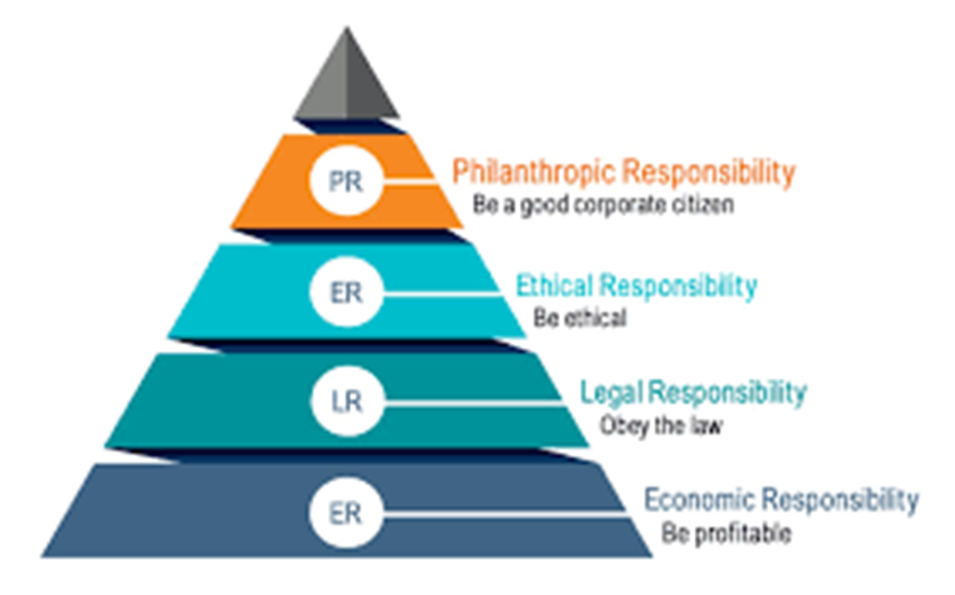
Corporate Social Responsibility Sample activities

Slide 11
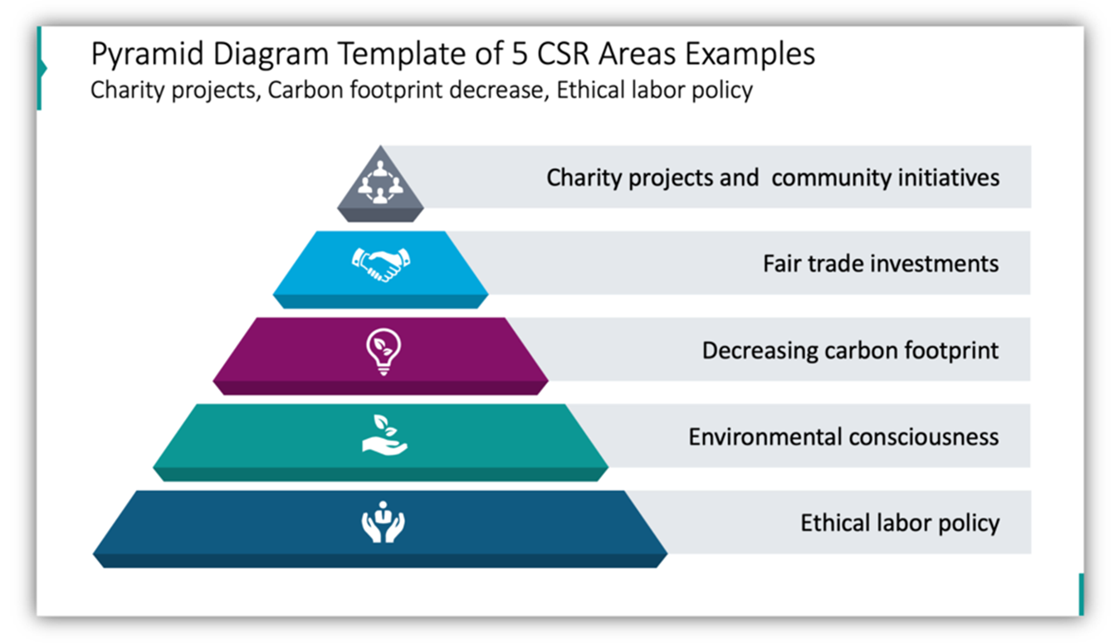
Corporate Social Responsibility Sample activities

Slide 12
Corporate Social Responsibility – CSR & SDGs
Many companies in countries with developing economies see clear links between CSR activity and the United Nation’s Sustainable Development Goals. Consequently, sustainable development goals (SDGs) and the concepts of corporate social responsibility (CSR) are leading the business activities of most public and private organisations. Companies may invest in areas such as poverty alleviation, community health, rural development, local capacity development and infrastructure report.
Remember, however, that CSR activities are determined by location. Would any of these activities be relevant to New Zealand?
Stakeholders and Corporate Social Responsibility (CSR) programme as key sustainable development strategies to promote corporate reputation—evidence from Vietnam. https://www.tandfonline.com/doi/full/10.1080/23311975.2021.1917333

Slide 13
Corporate Social Responsibility – CSR & SDGs
The New Zealand Department of Trade and Enterprise recommends that companies selling overseas align themselves with the SDGs.
“The SDGs can be great starting points for building a sustainability strategy, or for connecting an existing one with global goals. Using the SDGs means your business can:
Align with global sustainability goals that the world is collectively working towards.
Speak the same sustainability language as your global counterparts and many governments, organisations, and individuals around the world
Show its sustainability credentials by setting targets for your SDGs and measuring progress against them.
According to NZTE, 56% of the top 100 ASX- and NZX-listed companies reported on their SDGs in annual and sustainability reports. Companies most commonly reported on Goal 13: Climate action; Goal 8: Decent work and economic growth; and Goal 5: Gender equality.”
NZTE. Using Sustainable Development Goals in your sustainability strategy. https://my.nzte.govt.nz

Slide 14
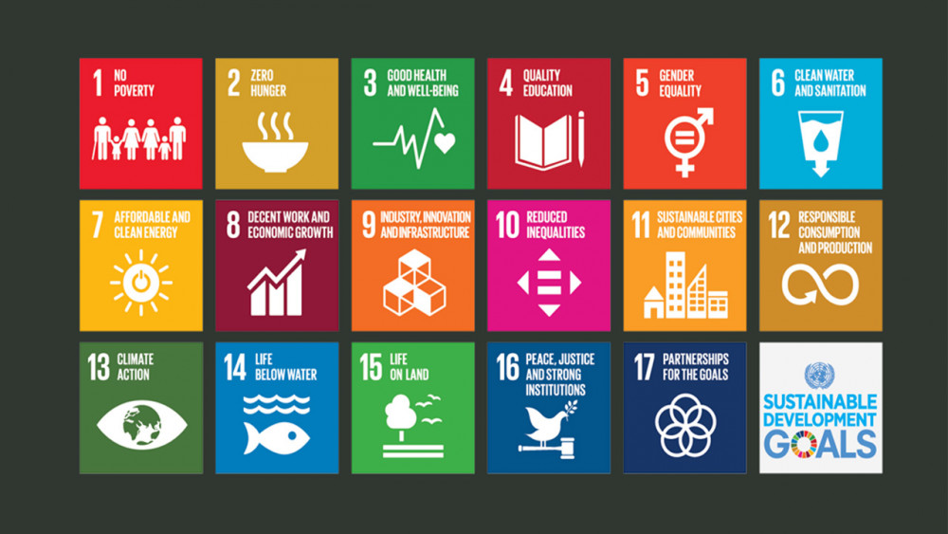
Corporate Social Responsibility The Sustainable Development Goals
https://www.c-r.org/news-and-insight/how-well-are-we-doing-peace-and-sustainable-development-goals

Slide 15
Corporate Social Responsibility – Stakeholders & CSR
“Companies today are being called upon by their shareholders . . . to not only boost the bottom line, but also to help address some of the . . . most challenging problems, including . . . economic development and the environment. Corporate stakeholders (which typically include shareholders, employees, customers, suppliers, communities, governments and regulators) demand that companies recognise a broader scope of responsibility in addressing those problems. Companies are increasingly working with stakeholders to understand their concerns on various environmental, social, corporate governance and economic issues . . . and to incorporate those concerns in the company’s decision-making processes.”
Harvard Law School Forum on Corporate Governance. The Corporate Social Responsibility Report and Effective Stakeholder Engagement. https://corpgov.law.harvard.edu/2013/12/28/the-corporate-social-responsibility-report-and-effective-stakeholder-engagement/

Slide 16
Corporate Social Responsibility
The Social License
A major manifestation of the role of stakeholders and their influence on CSR, is the emergence of the concept of the Social License. This is important when companies are working in sensitive areas such as mineral exploration. (Think about what we looked at last week in the powerpoint Recapping Maori Values)
The social license is based on the principle that communities and local interests have a valid role in determining whether or not a project will proceed. Communities can be powerful opponents of activities of which they disapprove and can take political action as well.
Hemi, T. (2023) Ngāti Ruanui and Taranaki iwi back anti-seabed mining bill, despite Labour snub. https://www.teaomaori.news/ngati-ruanui-and-taranaki-iwi-back-anti-seabed-mining-bill-despite-labour-snub

Slide 17
Corporate Social Responsibility
The Social License to Operate (SLO)
“The idea of an SLO, although originating in the mining industry, now has a much wider applicability across all business sectors. It can broadly be described as the ability of an organisation to carry on its business because of the confidence society has that it will behave in a legitimate, accountable and socially and environmentally acceptable way. It does not just derive from a need for legal or regulatory compliance but takes into account the inputs from a wider group of stakeholders and a sense of transparency and accountability in its external reporting. It is the foundation for acquiring operational certainty, realising future opportunities and lowering risk for the business.”

Slide 18
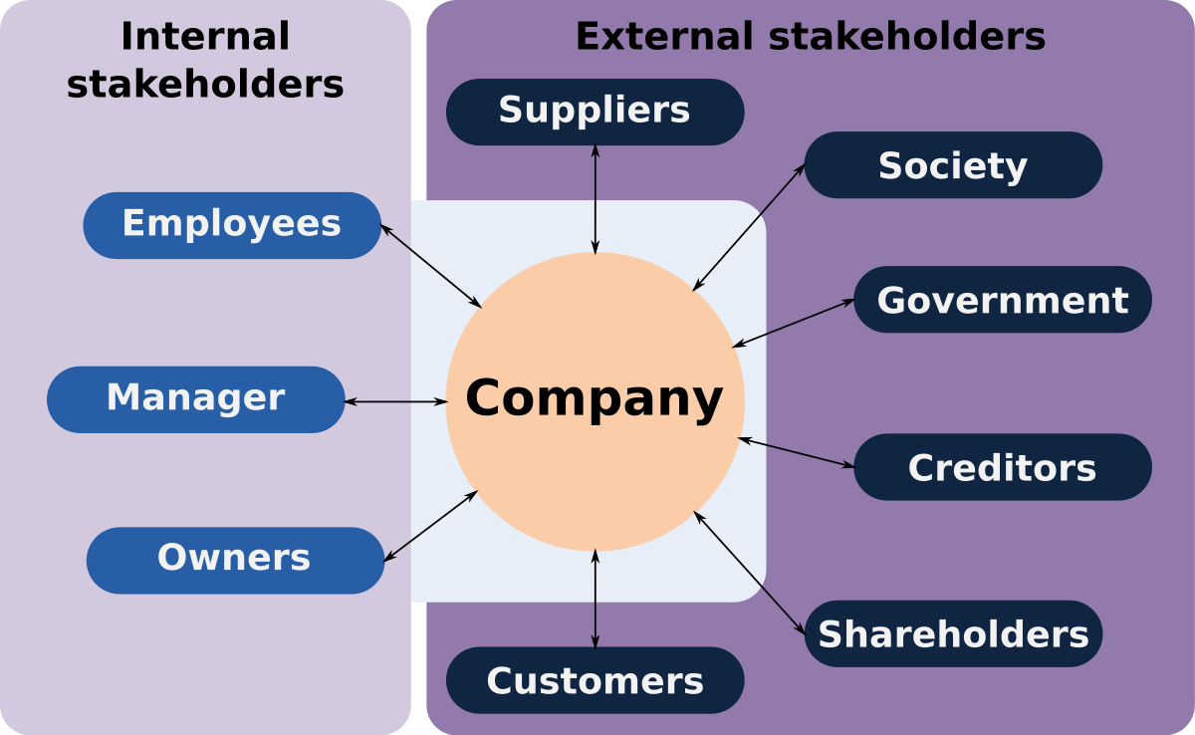
Corporate Social Responsibility The Social License to Operate

Slide 19
Corporate Social Responsibility The Social License to Operate
“There isn’t one commonly accepted definition of a social licence to operate. The following summarises the main concepts associated with the term SLO:
a measure of confidence and trust society has in business to behave in a legitimate, transparent, accountable and socially acceptable way;
it does not derive from a need for legal or regulatory compliance, instead is deemed to be the foundation for enhancing legitimacy and acquiring future operational certainty, realising opportunities and lowering risk for the business;
an unwritten contract between companies and society for companies to acquire acceptance or approval of their business operations;
the terms of a SLO are often project or location specific.”
Understanding the Social License to Operate Understanding the social licence to operate - Law Futures Centre Blog (griffith.edu.au)

Slide 20
Corporate Social Responsibility – CSR Reporting
Most major companies now produce annual CSR reports.
“The main intention of a CSR or sustainability report is to improve the transparency of organizations’ activities. CSR reports allow companies to measure the impact of their activities on the environment, on society and the economy. Companies can get accurate and insightful data which will help them improve their processes and have a more positive effect on society. A CSR report also allows companies to communicate with their stakeholders about their goals. This allows stakeholders such as employees, investors, media and NGOs to better understand the companies’ short, medium and long-term goals and make informed decisions. These decisions can range from investing in a business, buying its products, or protesting in the streets.”
CSR Or Sustainability Report: Definition, Meaning, Benefits & Examples From Companies.
https://youmatter.world/en/definition/definitions-csr-report-important-examples/

Slide 21
Corporate Social Responsibility – CSR Reporting
Issuing CSR reports has become more and more common, with 86% of the FTSE 100 companies in London doling so and 80% of the Global Fortune 250 companies following suit. However, CSR reports are not always easy to read and can still bury bad news amidst the statistics or not explain everything.
Harvard, Boston College Centre for Corporate Citizenship https://iri.hks.harvard.edu/files/iri/files/how_to_read_a_corporate_social_responsibility_report.pdf
You can find sample CSR reports in this week’s folder from Vodafone New Zealand (https://one.nz/our-company/corporate-responsibility/) which emphasises the environment, community interaction and diversity and multinational oil giant BP which emphasises its sustainability credentials. (https://www.bp.com/en/global/corporate/sustainability.html)

Slide 22
Corporate Social Responsibility – CSR Reporting
Working in your groups, read the BP CSR report and answer these questions:
What is the main focus on – the environment, the community, a particular group of stakeholders? Or is it something else?
What would you say about BP’s corporate tone? What kind of image is it trying to get over? Why do you think this might be?
How can you critically analyse the BP report? What elements would you use to try to create an accurate picture of what they are trying to say?

Slide 23
Corporate Social Responsibility – CSR Reporting
Working in your groups, read the BP CSR report and answer these questions:
Do you think the report would sound believable to stakeholders?
Now compare BP with Simplicity, would Simplicity invest in BP? Why?
Put up your answers on teams and compare them with another group.

